Slide 1
The UK’s European university
Maximising the societal impact of research: the use of impact indicators
Methods & Instruments for Assessing the Societal Impact of Research
6th Nov 2019, London
Simon Kerridge
Director of Research Services
orcid.org/0000-0003-4094-3719
@SimonRKerridge
https://inorms.net/activities/raaap-taskforce/
Steering Committee
Board Alternate, EARMA
Immediate Past Chair, ARMA
Notes:
13.30 Simon Kerridge Director of Research Services at the University of Kent, EARMA board member and former chair of the board of ARMA
Maximising the societal impact of research: the use of impact indicators
• Institutional impact strategy and responsible metrics
• Snowball Metrics
• Vertigo Ventures
45 mins

Slide 2
Simon
Ex Entrepreneur
Ex Researcher
Research Manager and Administrator
Entrepreneurial
Researching
Teaching
Open Research Advocate
Metric Tide
Research Administration as a Profession (RAAAP)
JHU Masters in Research Administration
Journal of Research Management and Administration
@SimonRKerridge earma.org casrai.org
Notes:
- Simon (30 minutes): Background information about the Metric Tide, how it was conceived, what have been the discussions leading to proposing the Responsible use of Metrics (focused on pre-and during Metric Tide), if possible including SSH perspectives. What have been your experiences at Kent in handling Metrics, efforts to sign DORA and any other relevant activities.

Slide 3
Simon
1987: Graduated (Natural Sciences)
1987-1990: Didn’t become Bill Gates
1990-1994: Researcher (Durham) x3 projects
1994-1995: Researcher (Sunderland) x3 projects
[including securing an additional partner]
1995-2012: Its complicated
2012-Present: Director of Research Services, University of Kent, UK
@SimonRKerridge earma.org casrai.org
Notes:
So I think we want to spend about maybe 10 mins each…
Talk about how we got to where we are… those decisions… things that make a difference…

Slide 4
Maximising the societal impact of research: the use of impact indicators
Institutional Impact Strategy
Responsible Metrics
Snowball Metrics
As an example of pathways to impact
Vertigo Ventures
As an example of evidencing impact
@SimonRKerridge earma.org casrai.org

Slide 5
Institutional Impact Strategy
A brief reprise of
What impact is
What it isn’t
How to facilitate it
How to assess it
Thanks to Dr Julie Bayley, University of Lincoln
@SimonRKerridge earma.org casrai.org

Slide 6
What is research impact?
‘For the purposes of the REF, impact is defined as an effect on, change or benefit to the economy, society, culture, public policy or services, health, the environment or quality of life, beyond academia’
Research England (REF)
'the demonstrable contribution that excellent research makes to society and the economy‘
UK Research and Innovation
The provable effects (benefits) of research in the ‘real world’
Increased – Improved – Faster – Safer – Reduced – More – Cheaper – Less – Lower – Disrupted
etc
Notes:
'the demonstrable contribution that excellent research makes to society and the economy‘ (UK Research and Innovation).
‘For the purposes of the REF, impact is defined as an effect on, change or benefit to the economy, society, culture, public policy or services, health, the environment or quality of life, beyond academia’ (Research England – REF 2021 guidance)
UKRI
Impact is the demonstrable contribution that excellent research makes to society and the economy. This occurs in many ways – through creating and sharing new knowledge and innovation; inventing groundbreaking new products, companies and jobs; developing new and improving existing public services and policy; enhancing quality of life and health; and many more.
Types of research impact
We aim to achieve research impact across all our activities. This can involve academic impact, economic and societal impact, or both:
Academic impact is the demonstrable contribution that excellent research makes to scientific advances, across and within disciplines, including significant advances in understanding, method, theory and application.
Economic and societal impact is the demonstrable contribution that excellent research makes to society and the economy, of benefit to individuals, organisations and nations.
Research England (REF)
For the purposes of the REF, impact is defined as an effect on, change or benefit
to the economy, society, culture, public policy or services, health, the environment or
quality of life, beyond academia.

Slide 7
The VERY shorthand version (*overly simplified and subject to disciplinary nuance, critical discourse, ethical reflections…..)
Research conducted here
“The wall”
Effects felt here
University
Society
Society

Slide 8
Impact is change (e.g.)
Reduced, less, lower…
Mortality
Waste
Risk
Cost
Staff turnover
Stress
Crime
Efficiency
Effectiveness
Wellbeing
Engagement
Access
Sales
Profit
Skills
Improved, more, faster, increased….

Slide 9
Impact is not….
Dissemination
Academic interest, citations, or publications metrics
Visibility, attention or reputation
Neat, linear or without effort
Just in the UK

Slide 10
Case studies describing specific examples of impacts achieved during the assessment period (1 August 2013 to 31 July 2020), underpinned by research at the institution in the period 1 January 2000 to 31 December 2020.
Marked on reach and significance
Ratings: Unclassified (no impact/ineligible) to 4* (Outstanding)
Worth 25% of total score
Notes:
Up to 20 FTE = 2 ICS
Then a further 1 ICS per 15 FTE
From 110 FTE = 1 per 50
(1 August 2013 to 31 July
2020)

Slide 11
5 Impact Lessons

Slide 12
1. We are all custodians of impact; we each have a piece of the puzzle
Notes:
Our institutions are divided up – TT, KT, research office, REF team and that cuts through connections for impact

Slide 13
Impact literacy
David Phipps
@mobilemobilizer
Available at https://www.emeraldpublishing.com/resources/
Bayley, J. and Phipps, D. (2017) Building the Concept of Impact Literacy, Evidence and Policy (available online) http://www.ingentaconnect.com/content/tpp/ep

Slide 14
Recognising complexity……
Knowledge transfer
Knowledge exchange

Slide 15
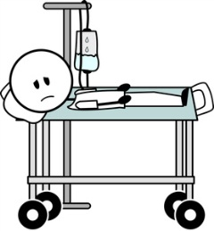
Knowledge mobilisation
Decision making informs policy
Policy informs research
Co-production
Commissioning
Clinical care change
Research co-design
Patient needs
Benefits to patients

Slide 16
2. We often speak different languages

Slide 17
Bibliometrics vs. impact measures
Bibliometrics
Demonstrate the scholarly attention for a research output
Citations based metrics (eg. citations, H index, field weighted citation impact, percentile rankings) calculate influence by the number of citations against certain benchmarks.
The basic unit of measurement therefore is the level of academic referencing.
Bibliometrics do not demonstrate change
Impact measures
Demonstrate the nature and extent of research-led changes (impacts) beyond academia
Impact does not always arise from a specific output; may be achieved through wider engagement during the research process
Impact measures may be quantitative or qualitative
Measurement is of anything which demonstrates change beyond academia, arising from research

Slide 18
University influence vs. REF impact
University influence
Research
Meeting the Frascati definition
Undertaken since 2000/ independent staff start date >00
With impact shown between 2013 and 2020
With evidence of impacts
Selected
(+ considered strongest) to meet FTE: case study ratio
SUBMITTED AS A 5 PAGE CASE STUDY IN A UNIT OF ASSESSMENT

Slide 19
3. Impact case studies show the sausages, not the sausage factory

Slide 20
Challenges
Impact resists templating
Assumption the problem is ‘lack of knowledge’
Requires time and effort
Requires knowledge broker and translation skills
Insufficient implementation planning
Can be an afterthought
May meet with resistance

Slide 21
King’s College London and Digital Science (2015). The nature, scale and beneficiaries of research impact: An initial analysis of Research Excellence Framework (REF ) 2014 impact case studies. Bristol, United Kingdom: HEFCE
Available from:
https://www.kcl.ac.uk/policy-institute/assets/ref-impact.pdf
149 fields of research
60 impact topics
36 UoAs
3,709 unique pathways to impact
Multidisciplinary research and impact

Slide 22
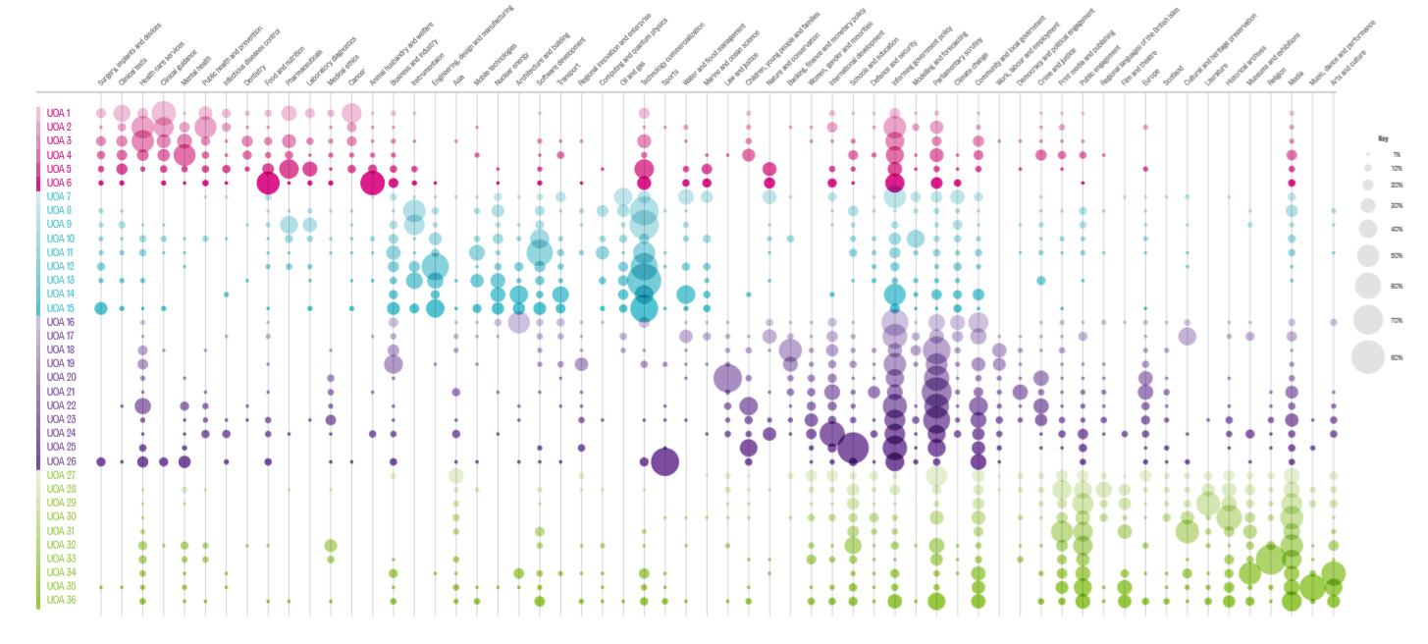
King’s College London and Digital Science (2015). The nature, scale and beneficiaries of research impact: An initial analysis of Research Excellence Framework (REF ) 2014 impact case studies. Bristol, United Kingdom: HEFCE
Available from:
https://www.kcl.ac.uk/policy-institute/assets/ref-impact.pdf
149 fields of research
60 impact topics
36 UoAs (Social Sciences in purple)
Multidisciplinary research and impact

Slide 23
4. We need healthy, connected institutions
Available at https://www.emeraldpublishing.com/resources/

Slide 24
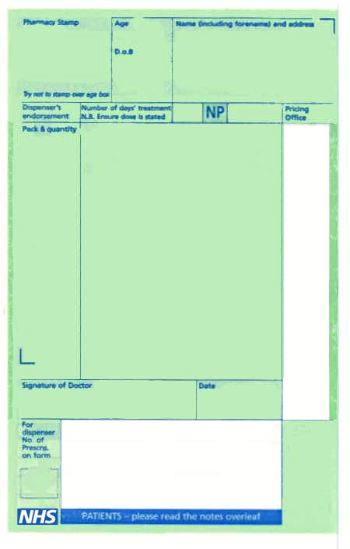
5 Cs of Institutional Impact Health
Commitment
Connectivity
Coproduction
Competencies
Clarity

Slide 25
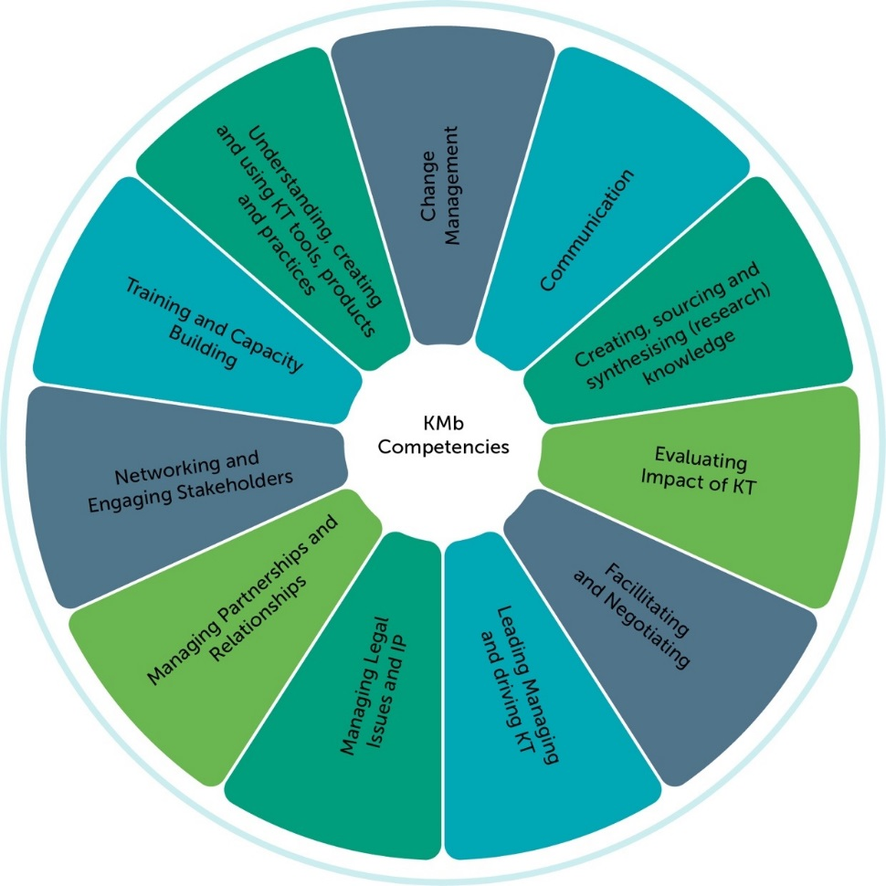
Competencies
Bayley, J.E, Phipps, D., Batac, M. and Stevens, E. (2017) Development and synthesis of a Knowledge Broker Competency Framework. Evidence and Policy (available online)
https://doi.org/10.1332/174426417X14945838375124

Slide 26
https://www.nihr.ac.uk/blogs/chasing-the-impact-unicorn-myths-and-methods-in-demonstrating-research-benefit/7479)
5. We have a tendency to chase impact unicorns
Notes:
https://www.nihr.ac.uk/blogs/chasing-the-impact-unicorn-myths-and-methods-in-demonstrating-research-benefit/7479

Slide 27
Meaning is everything
“When all the medics were talking about curing cancer….
… what I also wanted…..
….was to swallow”
Derek Stewart
Patient advocate after throat cancer in 1995: Blogger, Facilitator, Speaker with a Narrowboat and an OBE
Follow him on Twitter: @DerekCStewart

Slide 28
Impact is a challenge of connection
Imagine what’s possible when we work together
For commentary and slides see www.juliebayley.blog

Slide 29
Thank you TO
Email: jbayley@lincoln.ac.uk
Twitter: @JulieEBayley
Website: www.juliebayley.blog
Notes:
Go back to your institutions and think – where are the connections,
Speak with your impact officer and say what can WE do

Slide 30
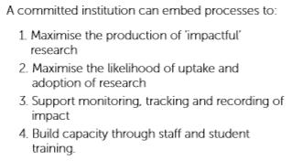
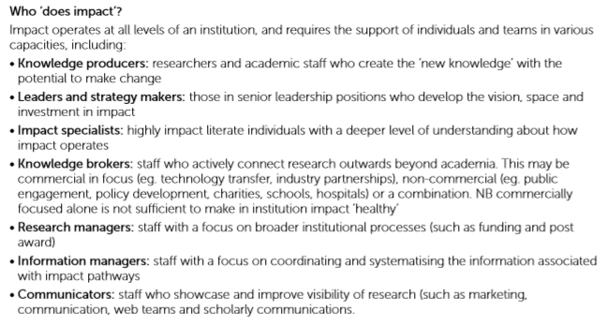
Institutional Impact Strategy - Summary
https://www.emeraldpublishing.com/wordpress/wp-content/uploads/Emerald-Resources-Institutional-Healthcheck-Workbook.pdf
@SimonRKerridge earma.org casrai.org

Slide 31
Institutional Impact Strategy - Summary
https://www.emeraldpublishing.com/wordpress/wp-content/uploads/Emerald-Resources-Institutional-Healthcheck-Workbook.pdf
@SimonRKerridge earma.org casrai.org

Slide 32
Responsible Metrics
https://sfdora.org/
https://responsiblemetrics.org/
http://www.leidenmanifesto.org/
And thanks to Lizzie Gadd for most of these slides!
https://thebibliomagician.wordpress.com/category/responsible-metrics/
@SimonRKerridge earma.org casrai.org

Slide 33
Overview
What are responsible metrics?
Why should we care?
How to implement a responsible metrics policy
How to actually do metrics responsibly
Who is responsible for responsible metrics?
A call for research evaluation literacy
Notes:
What are responsible metrics & why should we care?
How to roll out a responsible metrics policy
How to then DO metrics responsibly in line with that policy
Then to consider WHO is responsible for DOING these responsible metrics
And I’m going to end with a call for greater research evaluation literacy

Slide 34
Responsible metrics lead to better decisions
Comparing SSH with STEM on citation counts…
Comparing early & late-career academics on h-index…
Judging anyone by their ResearchGate score…
…just isn’t going to lead to a sensible decision, let alone a fair one.
Notes:
However the most persuasive argument for bottom-line-driven managers
For doing metrics responsibly
Is that responsible metrics are just sensible metrics – they lead to better decisions.
So,
Comparing SSH with STEM on citation counts…
Comparing early & late-career academics on their h-index…
Judging anyone by their ResearchGate score…
…just isn’t going to lead to a sensible decision (i.e. who to recruit or fund) let alone a fair one.
And who sets out to make bad decisions?

Slide 35
How to implement a responsible metrics policy
Notes:
So how are these organisations actually implementing their responsible metrics policies?

Slide 36
The need to accept your policy is just the beginning
This Photo by Unknown Author is licensed under CC BY-NC
Notes:
There’s always been a tension between those seeking to get their house in order
Before adopting a RM policy
Just so they’re not seen as hypocritical
And those who adopt policies as a statement of intent.
Whatever your aspirations are, there is a general agreement that your policy is always going to be the beginning, not the end of your responsible metrics journey
You’ve probably heard the expression:
“Culture eats strategy for breakfast”
You can have the best RM policy in the world
But if you have a culture of poor practice – or pockets of poor practice
The policy is going to have to work extremely hard to have any effect
But the beauty of such policies is that whereas in the past,
academics had no means by which to call out this behaviour
RM policies EMPOWER academics to blow the whistle (hence the image here)
and thereby slowly change the culture in their institution

Slide 37
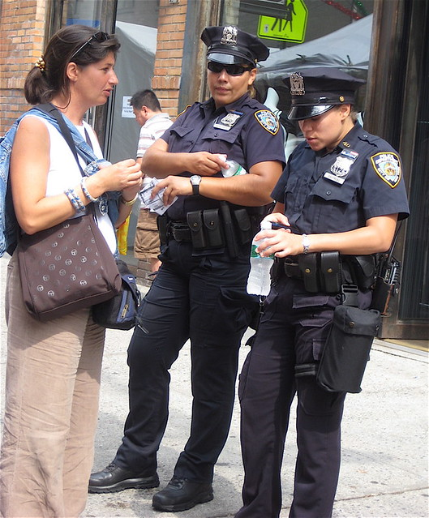
The need to consider the advise- police-judge spectrum
This Photo by Unknown Author is licensed under CC BY-SA
This Photo by Unknown Author is licensed under CC BY
Notes:
One thing we’ve learned is that different institutions see their policies in different ways.
Some see them as a source of guidance which need ‘community support;
Others put the police into policy and find ways to monitor and review adherence
And of course if you’re going to do that, you may find yourself having to make judgements as to whether evaluation activities actually adhere to policies or not.
My personal view is that if a policy is to have any teeth, then it needs the latter.
And as such…

Slide 38
The need for ownership at senior level
Notes:
There is a need for ownership of the policy at a senior level.
Our survey showed a bit of a worrying trend in the reduction of involvement by senior managers in developing such policies…

Slide 39
The need to manage upwards
From a mailing list:
“…there’s a desire to have…a metric (and they are keen on just one) against which to evaluate the performance of our research…. I’d be very interested to hear anyone else’s experiences …in dealing with the expectations of senior managers with this sort of thing.”
Notes:
Which probably explains why three respondents to our survey made reference to the value of a policy to influence senior managers to encourage them to make more responsible decisions.
This question was actually from a mailing list recently from a UK colleague who had been asked by their senior team to choose “JUST ONE” “METRIC” to evaluate the “performance of our research”.
And was asking for guidance as to how to deal with these sorts of requests from senior managers.
Stephen Curry, Chair of DORA, also made the observation that too often, it’s not librarians and research managers who need persuading about the responsible use of metrics, but more senior leaders.
I’ll come back to that thought later.

Slide 40
Introducing the INORMS SCOPE model
Start with your values
Context
Options
Probe
Evaluate
1
2
3
4
5
Notes:
Well, I chair the INORMS REWG
And to help practitioners move beyond principles to good practice
we have developed a process by which evaluation can be done responsibly
And also (where necessary) push back on requests from senior managers for doing things irresponsibly.
We’ve called it SCOPE
Start with your values
Context
Options
Probe &
Evaluate
And I thought I’d walk through this process in the hope that it might be useful to colleagues here.
SCOPE=9mins

Slide 41
START with what you value
Not with the data you have available
The Streetlight Effect
Not what others value
University autonomy: use it or lose it
“If my h-index is the answer, what is the question?”
Notes:
Well too often – as we saw with the colleague whose senior manager just wanted “one metric”
To evaluate ‘research performance’
We don’t start with what we value about our research performance
And work forward from there
We start with other things,
And work backwards.
The most common one being
As with this colleague’s experience
The data we have available…

Slide 42
The streetlight effect
Notes:
This is called the streetlight effect
Illustrated by this cartoon
A man looks for his wallet under the streetlight
Not because this is where he lost it
But because this is where the light is
We use bibliographic data to make so many of our research evaluation decisions
Not because it is a sensible measure always
But because it is so easily available.

Slide 43
Understand who & why you’re evaluating
Notes:
I’ve put together this matrix
Which has six different types of evaluation on the x-axis
From measuring to understand, to show off, to monitor, to compare, to incentivise behaviour right through to reward
And a range of entities of different sizes on the y-axis
So using data for ‘science of science’ type analyses – e.g. publication trends over time, for large entities such as countries
Isn’t going to have much impact on those entities
But if you’re using metrics to REWARD - especially at the level of the individual – is going to have a considerable impact and therefore the risk associated with getting it wrong is greater.

Slide 44
Do we need to evaluate at all?
Huge growth in incentivising behaviour through measurement
Campbell’s Law: “The way you measure me is the way I’ll behave”
Measuring is not always the best way to incentivise behaviour
Notes:
The other big question here is whether we need to evaluate research at all
Huge growth in incentivising behaviour through measurement

Slide 45
Options
Is your measure a suitable proxy for what you’re measuring?
Quantitative measures are for quantifiable things…
Citations, publications, money, students
Qualitative measures for qualifiable things…
Quality, diversity, excellence, value
Beware using quantitative indicators as a proxy for qualitative things
Citations ≠ quality
Ranking position ≠ excellence
Notes:
So the focus here is consider ALL our options for
Measuring what we VALUE
In this particular CONTEXT
And not just reach for numbers
And ultimately check if our measure is a suitable proxy for what we’re measuring?
A good rule of thumb here is that we should use
Quantitative measures are for quantifiable things…
e.g. Citations, publications, money, students
Qualitative measures for qualifiable things…
Quality, diversity, excellence, value
And we should use extreme caution when using quantitative indicators as a proxy for qualitative things
Citations ≠ quality
Ranking position ≠ excellence

Slide 46
Probe for potential negative impacts
Who does this discriminate against?
How could this be gamed?
What might the perverse incentives and consequences be?
Do the benefits of measuring outweigh the cost of measuring?
Is evaluating research actually going to make it any better?
Notes:
So this is where we need to ask 5 key questions in my view
Who does this discriminate against?
2) How might this be gamed?
3) What might the perverse incentives and consequences be?
Short termism
Goal displacement
Neglecting anything that’s not measured
Mental health challenges
4) Do the benefits of measuring outweigh the cost of measuring?

Slide 47
You don’t fatten a pig by weighing it
This Photo by Unknown Author is licensed under CC BY-ND
Notes:
As our PVCR is fond of saying
You don’t fatten a pig by weighing it
And you don’t make research better by measuring it
(Unless you use faulty scales)
And by the same token
You’re not going to make your research any WORSE by measuring it responsibly!
This is a question I’m often asked – are we putting ourselves at a disadvantage by doing responsible metrics?
No! Because you don’t make research any better or worse by measuring it.
But you might have a negative impact on your research environment by constantly measuring

Slide 48
Responsible metrics requires responsible people
Robust
Humble
Transparent
Diverse
Reflexive
Notes:
As I’ve said before
At the end of the day,
We talk about responsible metrics but
metrics can’t be responsible
They are inanimate objects
Only people can be responsible.
And I’ve argued before that we should apply our responsible metrics principles
To the PEOPLE doing the metrics
So these people should be
(to use the Metric Tide principles)
Robust
Humble
Transparent
Respect Diversity
And be reflexive.

Slide 49
Thank you for those slides to
Dr Elizabeth Gadd
Research Policy Manager (Publications)
Loughborough University
Skype: lizziegadd
Twitter: @lizziegadd
Email: e.a.gadd@lboro.ac.uk
http://orcid.org/0000-0003-4509-7785
http://about.me/elizabeth.gadd

Slide 50
Snowball Metrics
https://www.snowballmetrics.com/
• Defined and agreed by research-intensive universities themselves
• Commonly understood metrics that help uncover research strengths by benchmarking apples with apples, and thus provide valuable input into strategic decision making
• Tested methodologies that are not tied to any particular provider of data or tools
• Recipes that are owned by universities, and are available free-of-charge for use by any organization
• Aspire to become global standards and cover the entire spectrum of research activities
@SimonRKerridge earma.org casrai.org

Slide 51
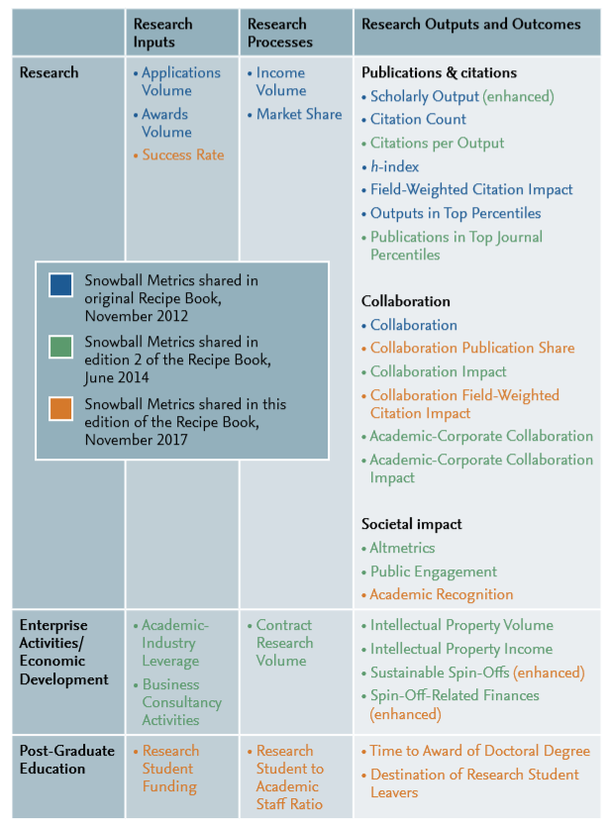
Snowball Metrics
@SimonRKerridge earma.org casrai.org

Slide 52
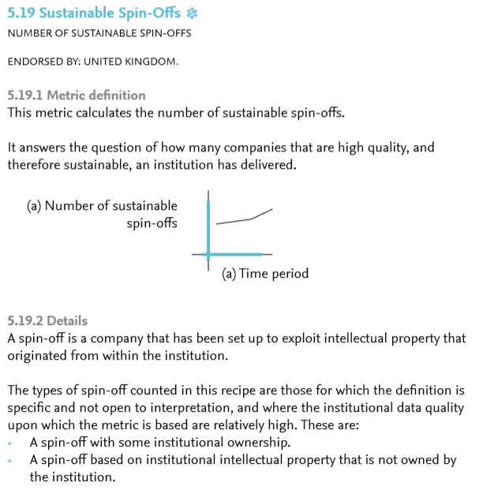
Snowball Metrics
@SimonRKerridge earma.org casrai.org

Slide 53
Snowball Metrics
@SimonRKerridge earma.org casrai.org

Slide 54
Vertigo Ventures
https://www.vertigoventures.com/
There are other systems, eg:
Kudos: https://www.growkudos.com/
Evernote: https://www.fasttrackimpact.com/evernote
(Fast Track Impact)
ImpactStory: https://our-research.org/
DCC: http://www.dcc.ac.uk/resources/how-guides/track-data-impact-metrics
Thanks to Renata McDonnell for these slides
@SimonRKerridge earma.org casrai.org

Slide 55
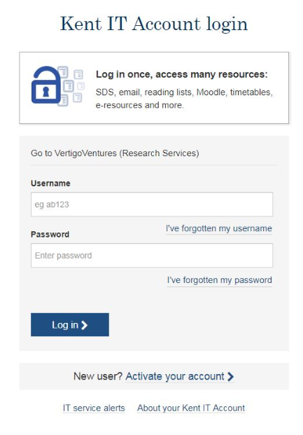
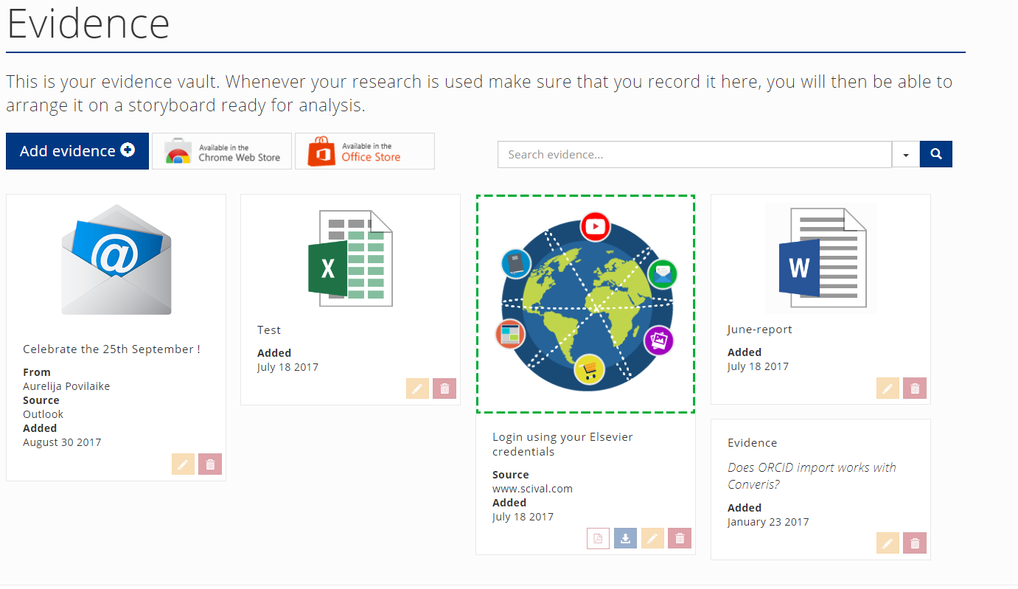
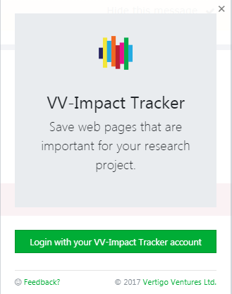
VV-Impact Tracker
Single Sign On
Intuitive
Fast tracking impact
Learning tool
Fulfil evidence requirement
@SimonRKerridge earma.org casrai.org
Notes:
Why VV
Then – how long did it take to implement the tool – slide 2
How many CS in 2014
Web based
Visually appealing
Intuitive
Search and filter
Flexible reporting
Taxonomy
Ongoing support
Training

Slide 56
Recent Feedback
“I’ve been using VV impact tracker to help me prepare a pilot case study for the REF pilot. I find it very intuitive. I am particularly keen on the feature that allows you to add VV to the Google Chrome toolbar for easy downloads/clipping to the VV Venture’s evidence vault.”
“Over all I think the system has a lot of potential. I’ve done a lot of impact recording and tracking for my work in the past (we were a case study in 2014) and this software will definitely make it easier.”
@SimonRKerridge earma.org casrai.org
Notes:
Kent is a client of VV and the academics are clients of the staff
Add screen shots of webpage

Slide 57
How we support / engage with staff
Web resources
Proactive and Responsive support
Scheduled and bespoke training
Engagement and support
VV, IS department
Events to promote Impact
i.e. Maximise Your Research Impact 2017 →
@SimonRKerridge earma.org casrai.org
Notes:
Kent is a client of VV and the academics are clients of the staff
Add screen shots of webpage

Slide 58
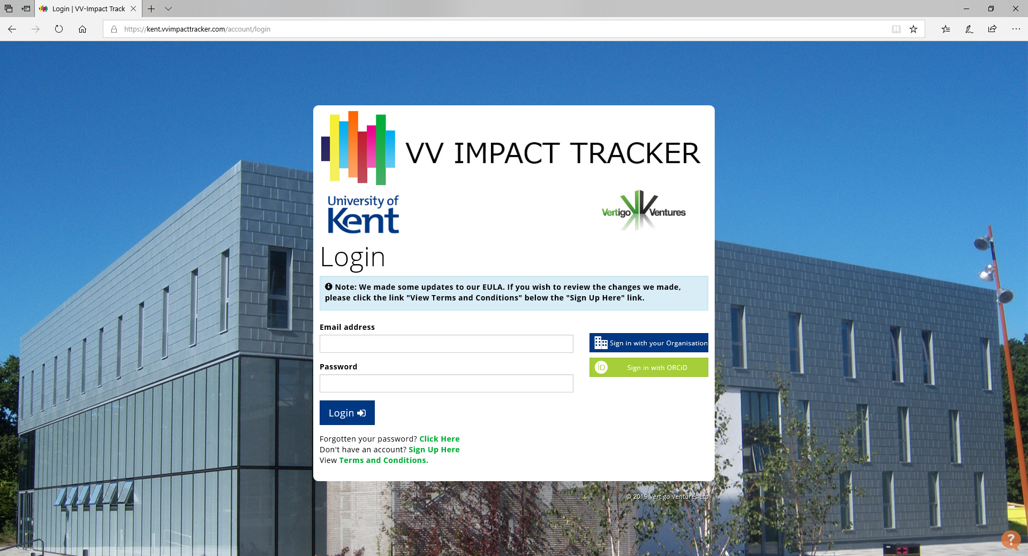
Challenges
New system
Additional support in certain areas
Providing training at the right time
@SimonRKerridge earma.org casrai.org
Notes:
Kent is a client of VV and the academics are clients of the staff
Add screen shots of webpage

Slide 59
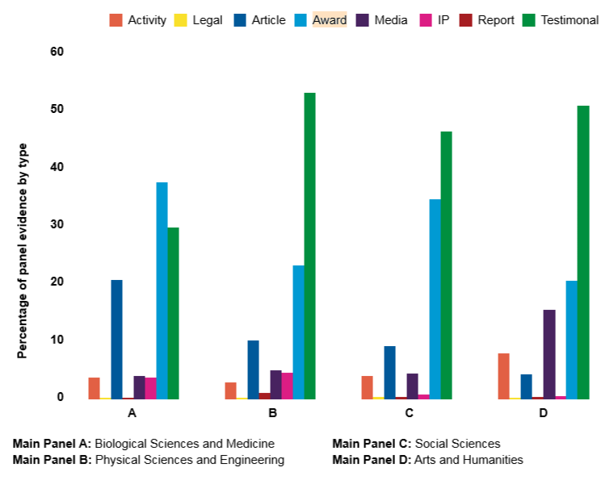
Types of Evidence
http://www.vertigoventures.com/wp-content/uploads/2018/11/HEFCE-2016_05_CollectingResearchImpactEvidenceReport.pdf
@SimonRKerridge earma.org casrai.org
Notes:
From all of the REF2014 submissions

Slide 60
Vertigo Ventures
UN SDGs
The eleven optional SDGs that universities can report on are: • SDG #3: Good Health and Well-Being • SDG #4: Quality Education • SDG #5: Gender Equality • SDG #8: Decent Work and Economic Growth • SDG #9: Industry, Innovation and Infrastructure • SDG #10: Reduced Inequalities • SDG #11: Sustainable Cities and Communities • SDG #12: Responsible Consumption and Production • SDG #13: Climate Action • SDG #16: Peace, Justice and Strong Institutions • SDG #17: Partnerships for the goals
@SimonRKerridge earma.org casrai.org

Slide 61
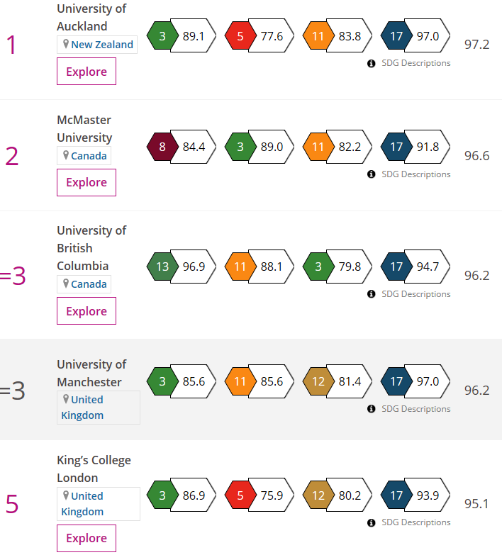
Vertigo Ventures (THE)
How is the ranking created?
A university’s final score in the overall table is calculated by combining its score in SDG 17 with its top three scores out of the remaining 10 SDGs. SDG 17 accounts for 22 per cent of the overall score, while the other SDGs each carry a weighting of 26 per cent. This means that different universities are scored based on a different set of SDGs, depending on their focus.
The score from each SDG is scaled so that the highest score in each SDG in the overall calculation is 100. This is to adjust for minor differences in the scoring range in each SDG and to ensure that universities are treated equitably whichever SDGs they have provided data for.
@SimonRKerridge earma.org casrai.org

Slide 62
Summary
Why do you want to measure / assess impact?
What data do you have / can you get?
What is missing?
Responsible Impact Culture…?
How will you approach it?
How will you embed it?
How will you uphold it?
@SimonRKerridge earma.org casrai.org

Slide 63
orcid.org/0000-0003-4094-3719
@SimonRKerridge
s.r.kerridge@kent.ac.uk
Dr Simon Kerridge
Director of Research Services
@SimonRKerridge earma.org casrai.org

